Slide 1

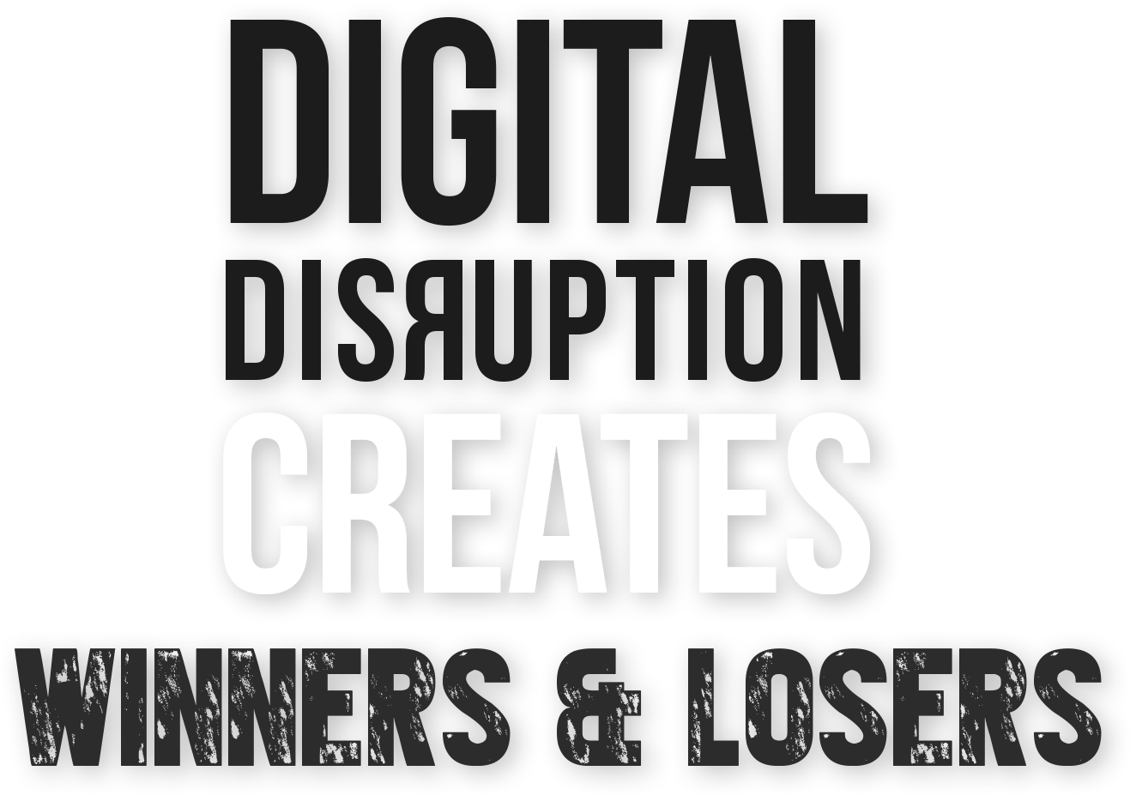

50% of CEOs expect their industries to be substantially or unrecognizably transformed by digital.
Source: Gartner, 2017
Notes:
Objective: Establish that there will be winners
and losers. Can’t afford to wait.
They need to choose how to deliver in order to
win
Example:
In fact, digital disruption is so big that the
world is being divided into winners and losers.
I’m sure you can think of cases where you’ve witnessed the disruption. For example (run through relevant examples)
Banking: PayPal vs retail banks
Transporation: Uber vs taxis
Retail: Amazon vs Barnes & Noble, tower records vs. iTunes
All of these examples demonstrate how a new entrant with digital ”only” strategy is redefining the customer engagement model.
Reflecting back to the statement that “the app is the business”, now has significant meaning.
What your digital teams are more critical to your business success than ever before.
It’s not just the change in the market, but your choice on how you deliver that will make the difference between winning and loosing

Slide 2

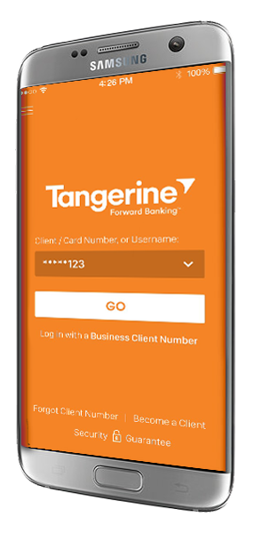
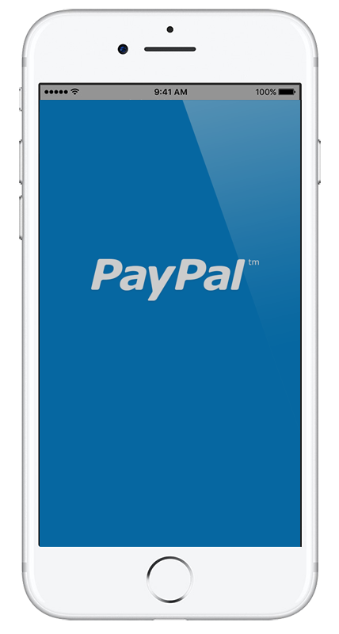
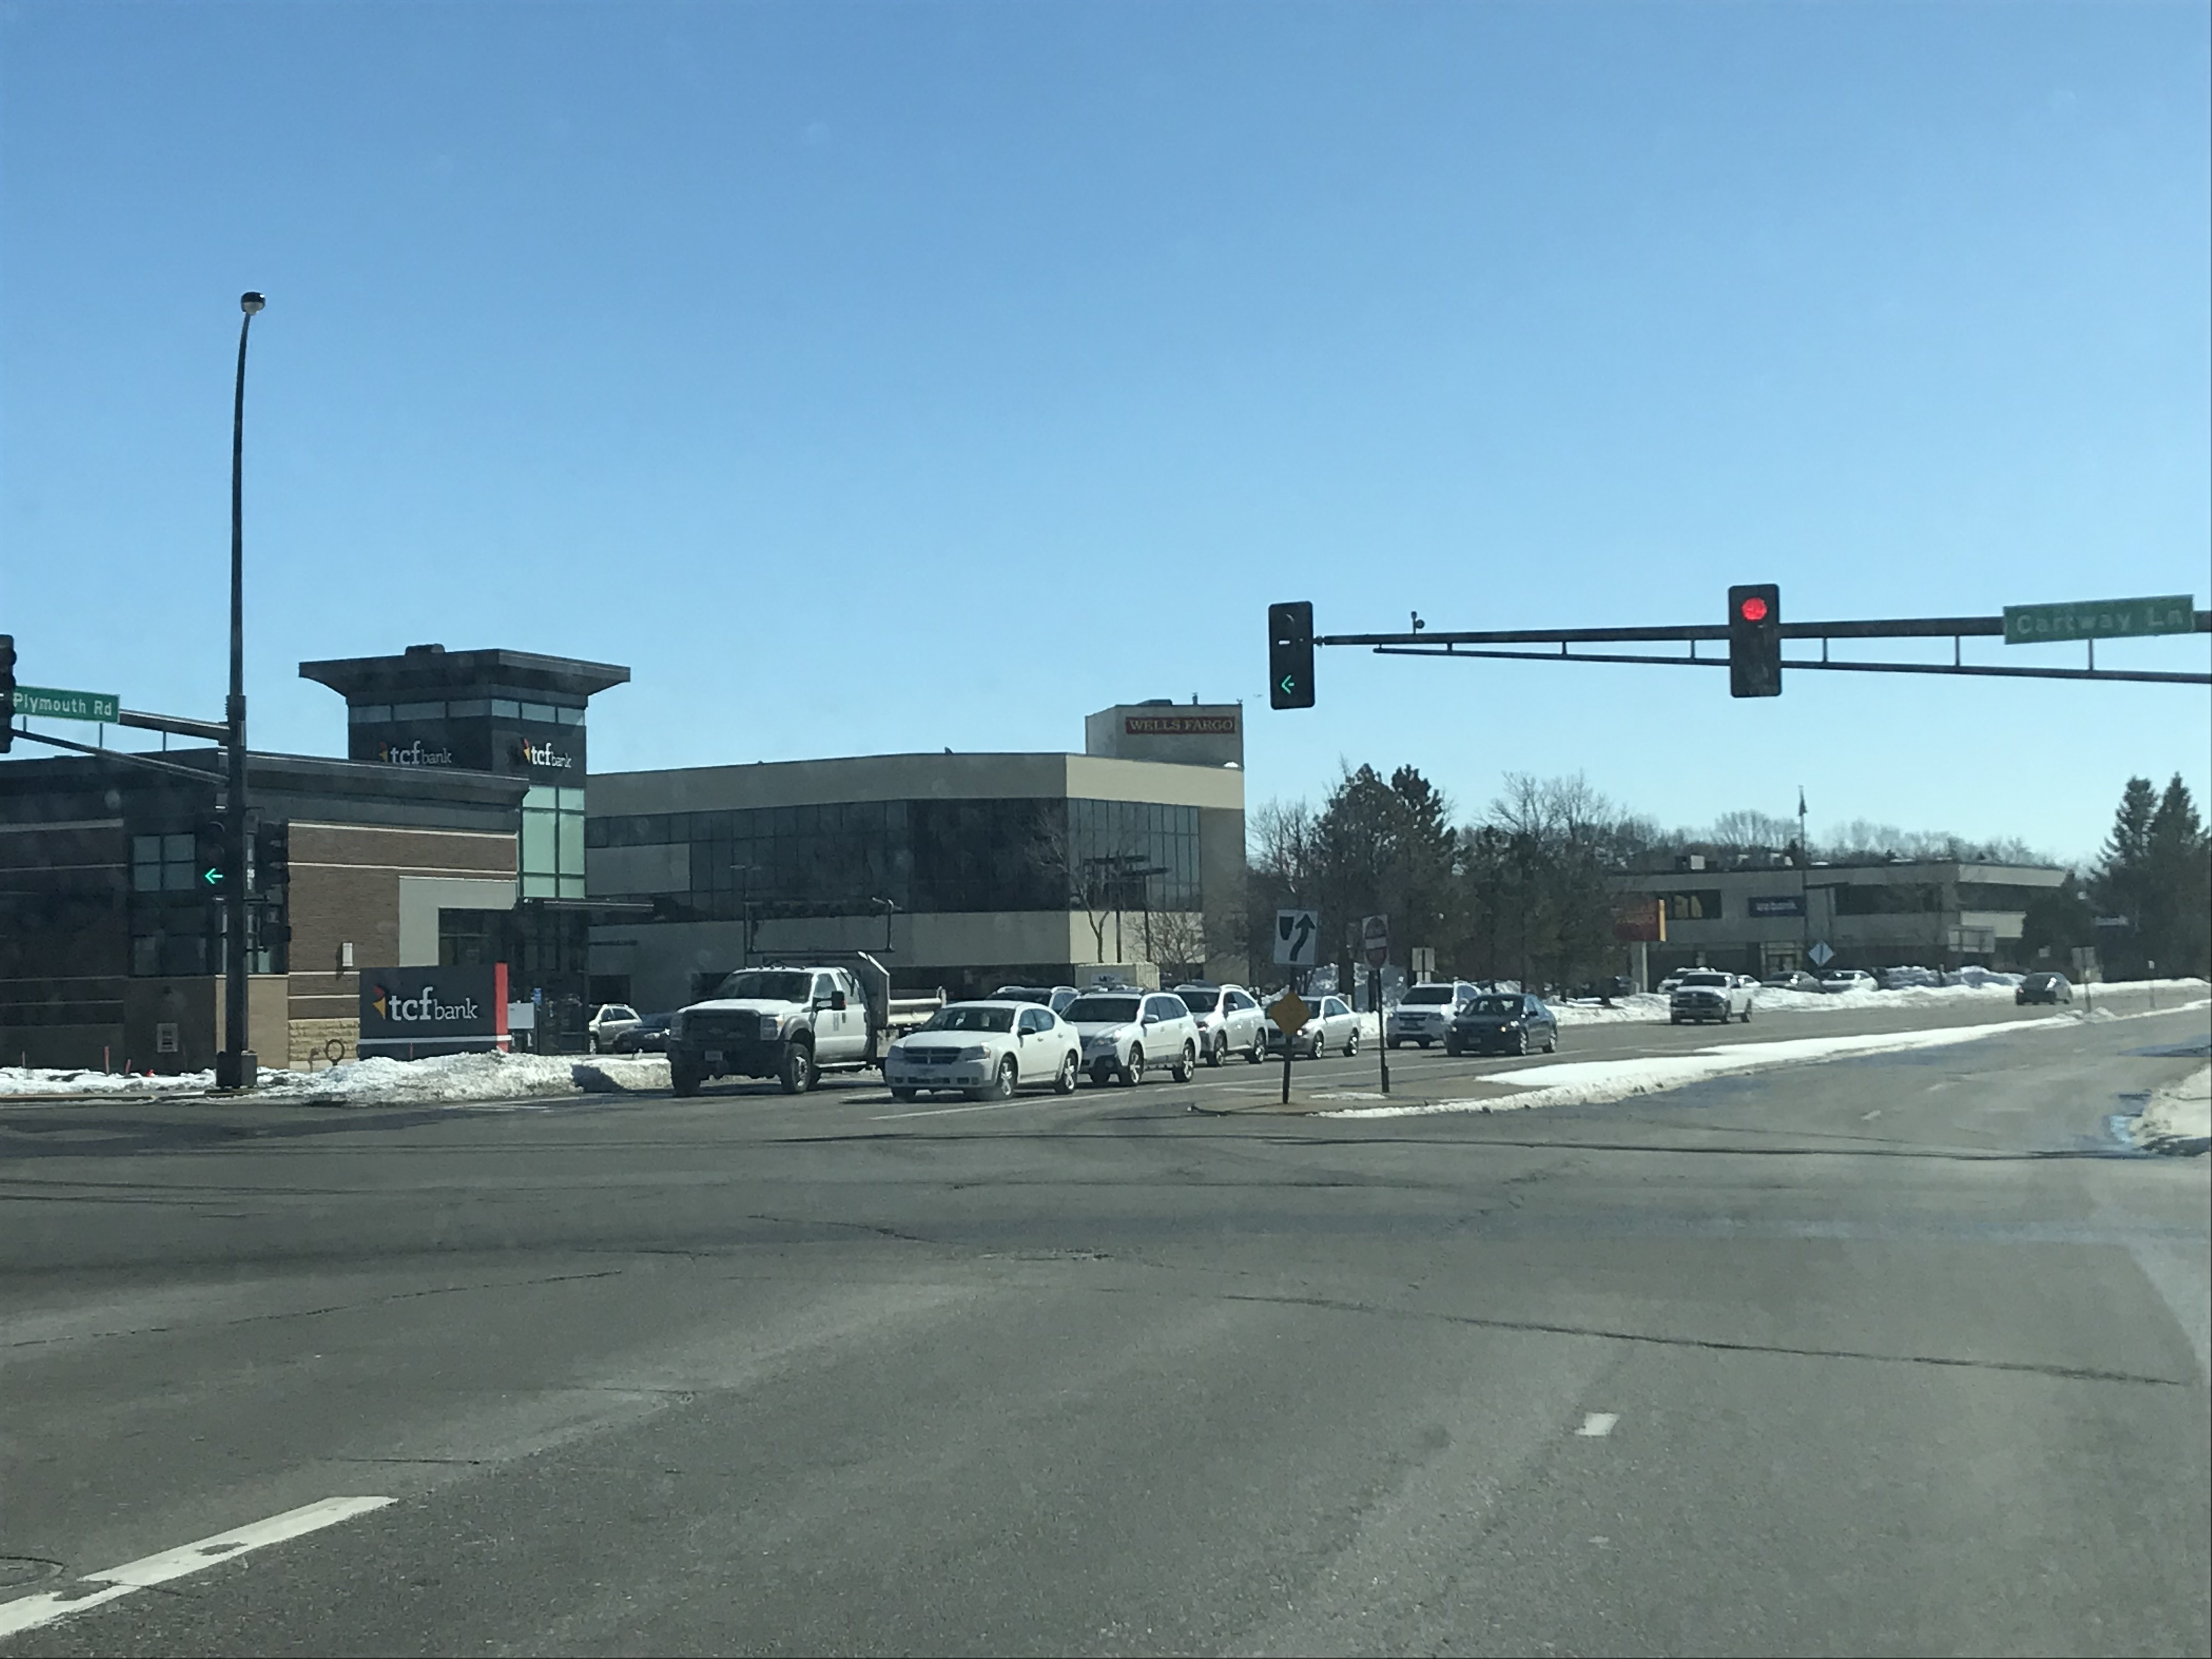
Over the next decade, as many as half of all U.S. bank branches could disappear *
*Keefe, Bruyette & Woods Research - 2017
“Consumer visits to retail bank branches are set to drop 36% between 2017 and 2022, with mobile transactions rising 121% in the same period, as customers increasingly shift to accessing their banking information via apps and secure, responsive sites on their mobile devices.” – The Financial Brand, July 2017
Notes:
Objective: Connect to the size of disruption the
business is going through
Start with the “world is changing” and this is
how big the digital transformation is to their
business
Create a slide like this that captures their industry dynamics. Have a reference from one of your/Perfecto accounts (consult PG metrics library if needed to identify one).
Example: Financial Services
Digital transformation is redefining how businesses engage with their customers and deliver their products/services. One of our financial customers, The CTO of BofA, told us “the app is the bank”. This is a very profound statement of the business today from one of the most recognizable U.S. banks.
And it’s not just BofA undergoing a digital transformation. “In the next decade, as many as half of U.S. bank branches could disappear” Going digital is not an option, but a requirement to stay in business in this industry.

Slide 3


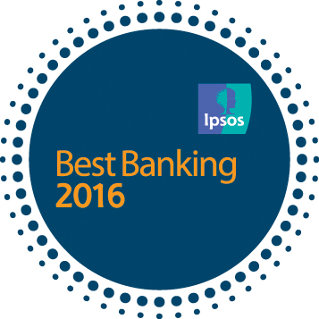


What does a digital winner look like?
“Our mobile app is the Bank.”
Charaka Kithulegoda, CIO
“Tangerine's goal is to remain an innovator in online, mobile, and digital banking.”
Peter Aceto, CEO
Innovation
Mobile Apps
Remote Check Deposit
Voice Biometrics
Apple Watch App
Secure chat
Digital New Account Opening
First mover with innovative mobile capabilities
Consistently high app store ratings
Winning market share from digital laggards
Demonstrates agility to meet changing customer needs
Optimized delivery pipeline to maximize innovation and user experience
Reactive to feedback from customers, operations and within Dev/QA
Notes:
Objective: Establish what a winner looks like.
Set the stage that the commitment is high, and
the businesses that are winners are committed
to digital, and we are working with them today.
Create a slide like this for your particular
customer segment. Also research their competition to see if they are leading or following and what insights you can bring to the conversation. We have many successful customer to choose from. Look through the PG metrics library to find one relevant to your customer.
Example:
And we are working with these winners. Here is a customer of ours.
Look at what Tangerine does and the innovations they have brought to market. This is how they consistently win in digital engagement. And how they are taking market share from the laggards by being first to innovate.
More importantly, the CEO/CIO are committed to their digital strategy. It is central to the business strategy.
They are committed to their customers and act fast though an optimized delivery pipeline to achieve their digital strategy.
Their entire delivery pipeline is built to support this commitment to be disruptive, to win.

Slide 4
What does a digital winner look like?
“Building mobile first apps means that you have to have a solid idea of the customer, you have to build engaging apps, and you have to measure relentlessly”
Werner Vogel, CTO
“We've had three big ideas at Amazon that we've stuck with for 18 years: Put the customer first. Invent. And be patient.”
Jeff Bezos, CEO
Innovation
Amazon Go
Fresh
Dash
Echo/DOT/Alexa
Prime
1-hour delivery
Kindle
First mover with innovative web and mobile products/services
Relentless focus on customer experience
Winning market share from digital laggards
Demonstrates agility to meet changing customer needs
Optimized delivery pipeline to maximize innovation and user experience
Reactive to feedback from customers, operations and within Dev/QA
Notes:
Objective: Establish what a winner looks like.
Set the stage that the commitment is high, and
the businesses that are winners are committed
to digital, and we are working with them today.
Create a slide like this for your particular
customer segment. Also research their competition to see if they are leading or following and what insights you can bring to the conversation. We have many successful customer to choose from. Look through the PG metrics library to find one relevant to your customer.
Example:
And we are working with these winners. Here is a customer of ours.
Look at what Tangerine does and the innovations they have brought to market. This is how they consistently win in digital engagement. And how they are taking market share from the laggards by being first to innovate.
More importantly, the CEO/CIO are committed to their digital strategy. It is central to the business strategy.
They are committed to their customers and act fast though an optimized delivery pipeline to achieve their digital strategy.
Their entire delivery pipeline is built to support this commitment to be disruptive, to win.

Slide 5

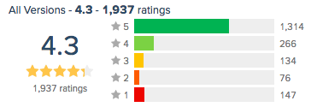
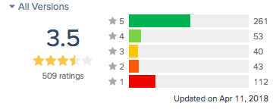
How do you reach & engage more customers?
Mayo Clinic CEO John Noseworthy’s goal is to bring the Mayo Clinic's expertise to 200 million people around the world by 2020. “Speed in healthcare is essential, which is why it’s important to take advantage of an increasingly hyperconnected world.”
65% of web traffic to MayoClinic.org and through its apps is coming from mobile.
A recent study from the Journal of Medical Internet Research finds 58% of mobile phone owners had downloaded health-related mobile apps, but about half had stopped using them.

Slide 6

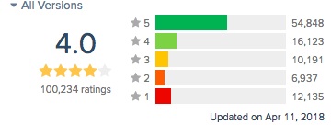

Forbe’s Brian Solis: “Impatience is a Virtue”
“As more devices and apps deliver instant gratification, the more it sets a new standard for customer expectations.”
“businesses in every industry will have to cater to “right now” consumers in mobile-first micro-moments or risk missing these critical engagement opportunities.”
“You can thank the likes of Uber, Lyft, Postmates, and even Amazon Prime for stoking the on-demand economy. People expect not just information now, but the actual products and services now, too. ”

Slide 7
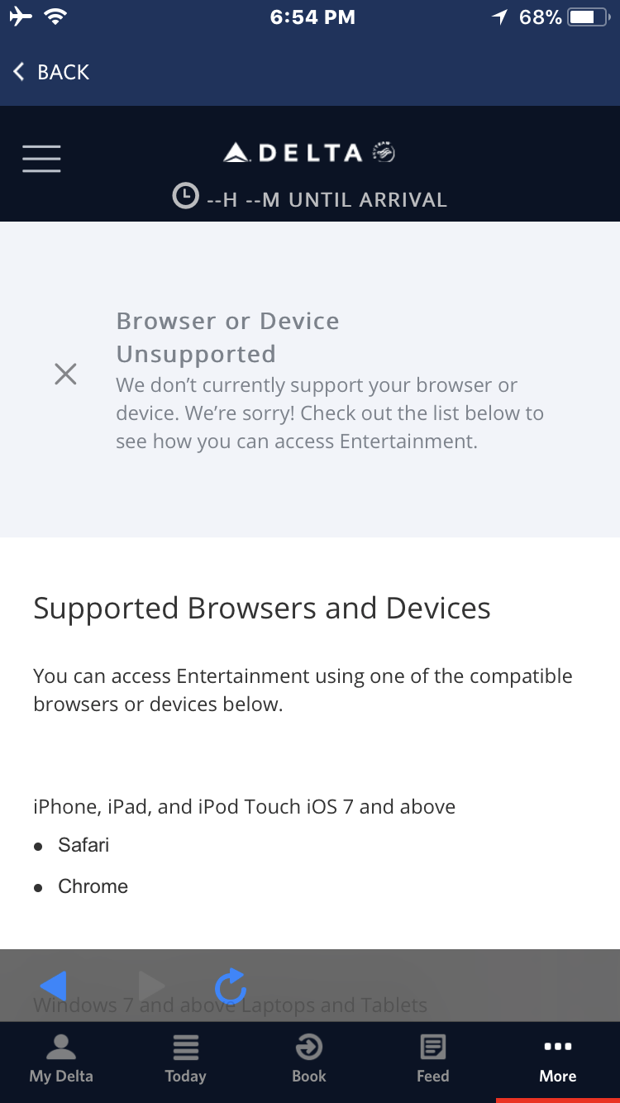
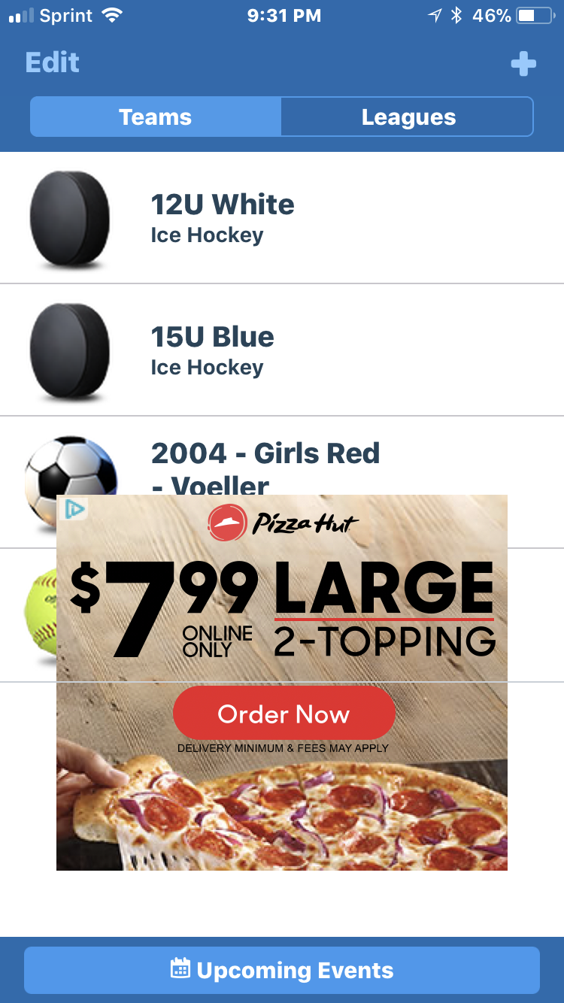
Mobile imperfection….from my personal experience

Slide 8
Unhealthy responsive web experience…

Slide 9
The Application Delivery Pipeline
Notes:
Objective: Introduce the pipeline concept to tie
together different teams (dev, test, ops) and
Identify their most pressing challenges.
Example:
How do you, Mr. Customer, deliver software?
What keep you up at night?
Let me start by defining what an optimal delivery pipeline looks like. Then dive into the challenges we see across many of our customers in achieving an optimal pipeline.

Slide 10
Goal: Get more done – a better delivery pipeline
Optimized Delivery Pipeline
Innovation Throughput
Quality of Output
Time
Cost
Time & Cost
New Functionality
(Innovation)
User experience
Users
PLAN
CODE
BUILD
TEST
RUN
Notes:
Objective: Gain agreement that success
requires an efficient pipeline.
Example: What is an optimal pipeline?
Drives as much innovation as possible
Has the least friction as possible across teams
Achieves fast TTM
Maximizes user experience
Team constantly gets feedback across dev, qa, ops so they know where issues exist and where to address them (transparent and visible process)
An optimal pipeline is how winners achieve their value drivers of <read from slide> and deliver on their digital strategy.
But reality is often far from this “theoretical” construct.

Slide 11
Delivery pipeline challenges
New Functionality
(Innovation)
User experience
Users
PLAN
CODE
BUILD
TEST
RUN
Notes:
Objective: Uncover value drivers and pain
In the slides that follow, use them to tune-in to
the value drivers that are most important, what
their blockers are to achieving success.
Example:
This is an ideal pipeline. Let’s talk about the challenges you currently have that are
preventing you from optimizing your pipeline…
What is most pressing for you today?
From a customer perspective
From on Ops perspective
From QA
From Dev
From the business

Slide 12
Delivery pipeline challenges
New Functionality
(Innovation)
bugs
User experience
Users
PLAN
CODE
BUILD
TEST
RUN
Gaps in digital test coverage –
impact user experience, brand and adoption
Notes:
Objective: Uncover pain from bugs/defects.
Value driver: Quality, UX Risk
Pain: User experience → brand → business
Research the customers app ratings or
reputation in the market. Have questions
specific to them.
Example: Bugs/Defects
In reality, there are no software without bugs. Bugs are introduced that impact your user experience, effect the brand reputation, and can impact adoption by new users. From my research into your company, here are my observations:
<app ratings, customer satisfaction report out>
Bugs are a symptom of an inefficient pipeline and can drive up costs, negatively effect quality, and slow your innovation capability.
Pain is business impacts from poor quality, symptom is poor app ratings/negative customer feedback:
Lost transactions
Missed app adoption goals
Tarnishing the brand through poor experience
Is your app store rating consistent with your view of your app quality?
What does it cost your organization for a customer who abandons the app?

Slide 13
Delivery pipeline challenges
New Functionality
(Innovation)
bottlenecks
bugs
Bug fixes – unplanned work
(found in QA or Production)
User experience
Users
PLAN
CODE
BUILD
TEST
RUN
Bug fixes backlog – impact velocity
Gaps in digital test coverage –
impact user experience, brand and adoption
Notes:
Objective: Uncover velocity blockers
Value driver: TTM
Pain: bugs → re-work → slows TTM
Example:
Bugs/Defects impact innovation velocity by
adding to the work-in-process. Bugs come back to the development team as fixing tasks. This is not planned work, and takes valuable cycles from the development team to address. Result is trading feature work for fixing work.
We’ve found that defect work can consume up to 40% of developer resources. Think about how many more features you can deliver if this blockage can be reduced or eliminated.
Story:
Australia post, Parcel tracking app
Find bugs late in the process, feedback across teams is slow, results in accumulation of defects (growing issues backlog)
Had 3 months of defect backlog
Hard to triage issue because of too many teams on one issue (5 different teams on call to resolve across dev, test, backend services, production, management)
5 hours alone spent on a call to identify one issue and develop a plan to resolve
Pain is slow TTM, symptom is growing backlog in both:
Defects
New features
What does your backlog look like?
How long does it take to reproduce the issue?

Slide 14
Delivery pipeline challenges
$$$$
Focus on quality too late in SDLC – impact cost and velocity
$$$
$
New Functionality
(Innovation)
bottlenecks
bugs
Bug fixes – unplanned work
(found in QA or Production)
User experience
Users
PLAN
CODE
BUILD
TEST
RUN
Bug fixes backlog – impact velocity
Gaps in digital test coverage –
impact user experience, brand and adoption
Notes:
Objective: Bottle necks across team
Value drivers: Cost, TTM
Pain: bottle necks → increasing costs
Example:
The later we find bugs, the more expensive they
become to fix. Both cost and velocity are impacted negatively.
<Story>
Pain is bugs slow everything down, symptoms are increasing costs to deliver:
Where in the process do you find most of the issues?
How long does it take to resolve a defect?
How many resources are consumed fixing?

Slide 15
Delivery pipeline challenges
$$$$
$$$
$
New Functionality
(Innovation)
bottlenecks
bugs
Bug fixes – unplanned work
(found in QA or Production)
User experience
Users
PLAN
CODE
BUILD
TEST
RUN
Maximize Digital Test Coverage
Maximize
% of Automation
Feedback Loop Time
Quality Across Dev-QA-Ops
Shift left
Shift right
FOUR PILLARS OF SUCCESS
Notes:
Objective: Introduce our POV for success
Example:
The key to solving these problems are what we
define as the four pillars of success.
We’ve solved these problems with our customers. We solved it with our own R&D teams. And we can solve them with you.
We need to maximize test coverage. Why? If we don’t test for them early, during code and build, they will show up as bugs late in the process.
We need to maximize automation. If it’s done manual, we will never be able to get it done in time and the backlog will continue to grow.
We have to have an efficient feedback loop. We need to understand what happened, and be able to drill down/zoom in very quickly where the problem is.
We need to quality to be everywhere not just in QA. We need quality to embedded into coding, building, testing, and in production use.
If we do these 4 things, we will see success. It’s a recipe for success.

Slide 16
Minimum Required Capabilities
Notes:
Objective: Introduce MRCs tied to their success
Example:
So we have a recipe for success. Now we need
the ingredients, or the minimum required
capabilities.

Slide 17
Minimum Required Capabilities
PILLAR OF SUCCESS
MRC
Maximize Digital Test Coverage
Test realistic user experience scenarios
Digital coverage against the market: all platforms + mobile sensors
Same-day platform support
1
Achieve High Degree of Automation
Automation of your full delivery pipeline
Scalable automation running parallel and unattended
Automate 90% or more of test cases
Use industry standard automation frameworks
2
Fast Feedback
Reduce the noise
Digital centric view of test reports across platforms
Fast drill down from CI job > platform > test suite > test > step > error
Executive dashboard with fast drill down into actionable detail
3
Integrate Lab Across
Dev-Test-Ops
Full lab access from within your IDE of choice
Integrated with DevOps pipeline tools (CI, FW, IDEs, etc.)
Test during coding, test in CI, test in QA, test in Production
24/7 managed test environment
4

Slide 18
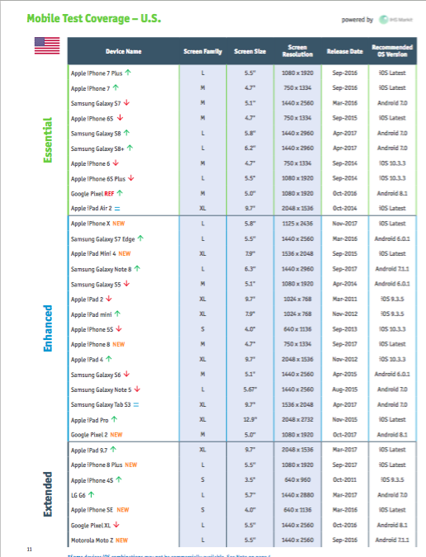
Maximizing Digital Test Coverage
?
X
?
?
?
?
?
?
✔
X
?
?
?
?
Test Cases…
?
✔
?
?
✔
✔
?
?
?
?
✔
X
?
?
X
✔
X
✔
?
?
Network Conditions
1
?
?
Background Apps
Location
Orientation
n
Platform/OS
Platform Coverage…
User Conditions…
Factors – Digital Test Index Q1 2018
Notes:
A few notes
Each block panel is grouped “twice” — ungroup once you will have the panel break itself into rows — ungroup a second time the rows become single blocks etc.
You can double click on the face of the block to change its color and symbol within.

Slide 19
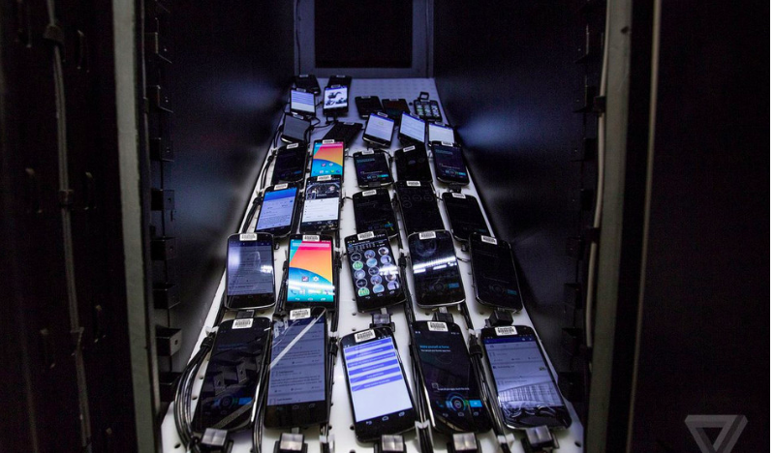
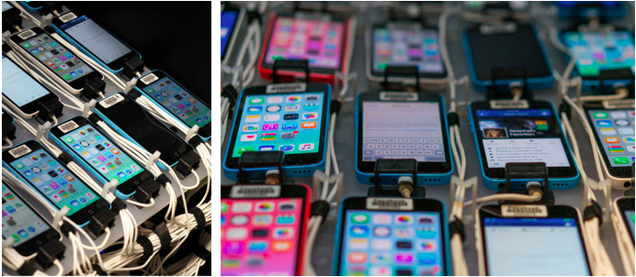
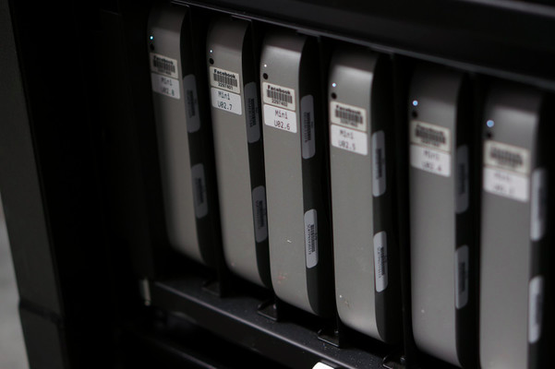
Facebook’s focus on test coverage
Facebook Reveals Secret Mobile Testing Lab Filled With Thousands Of Devices
Constantly testing their apps across thousands of units (2,000 real devices growing to 4,000)
The same testing process is applied to the Facebook app, Messenger, and Instagram. Whenever a change is made, it's first tested across all of the devices
Every rack has its own WiFi signal
No device emulators

Slide 20
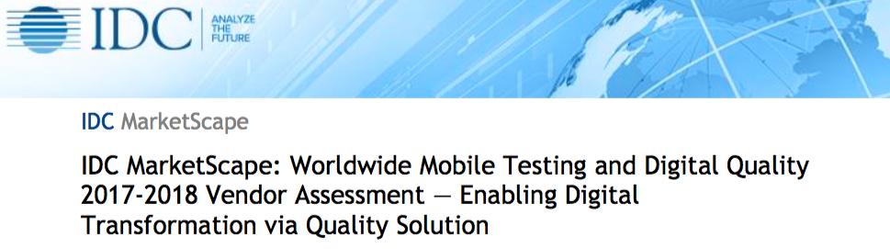
IDC says automation is critical to quality…
IDC MarketScape: Worldwide Mobile Testing
And Digital Quality 2017-2018
“Companies investing in software in a digital economy that remains volatile with constrained resources and complex deployment challenges are benefiting from and committing to digital quality approaches and automation.”
“IDC sees an urgent need for approaches to software quality that extend to digital environments. User engagement is driving adoption and uptake in this area for automated software quality (ASQ).”
“We see mobile testing in the forefront and digital quality as the overall strategic trend for automation…”
“We are seeing a blurring of the line that was rigid between development and software quality — increasingly, quality spans dev/test and production as part of continuous integration (CI) and the end-to-end DevOps life cycle and also encompasses security with code analytics. This trend applies also to mobile and digital platforms.”

Slide 21
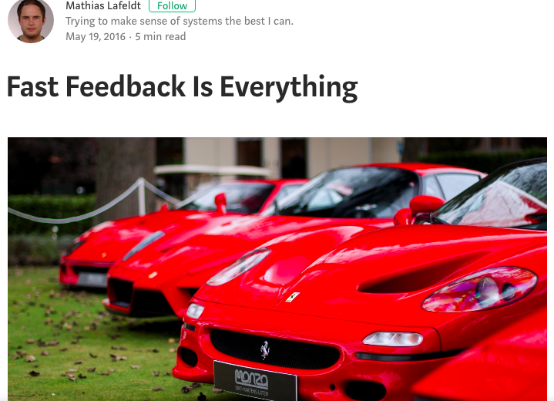
Fast Feedback is everything…
As an engineer, you should constantly work to make your feedback loops shorter in time and/or wider in scope. — @KentBeck
“There are a couple things you can do to shorten the feedback loop. Certainly the first technique coming to mind is isolated testing, which involves eliminating (slow) external dependencies like databases. Besides trying to implement faster tests, however, you can also optimize the way you run them…”

Slide 22
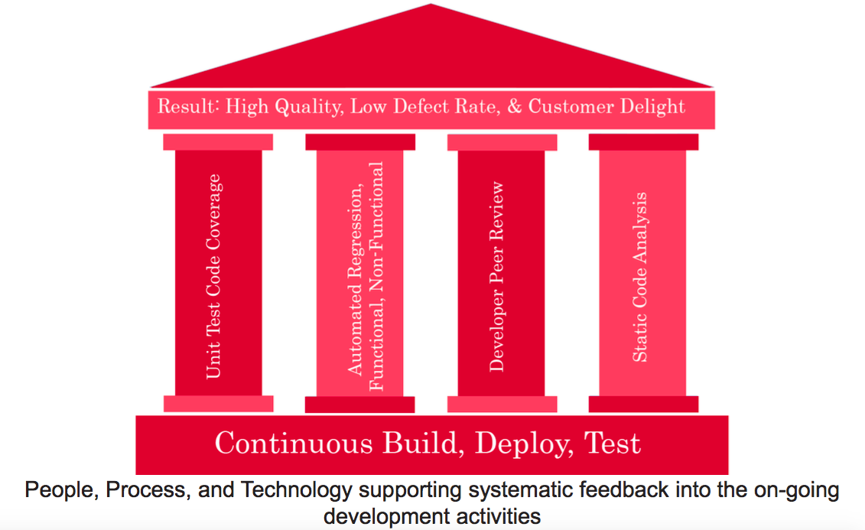
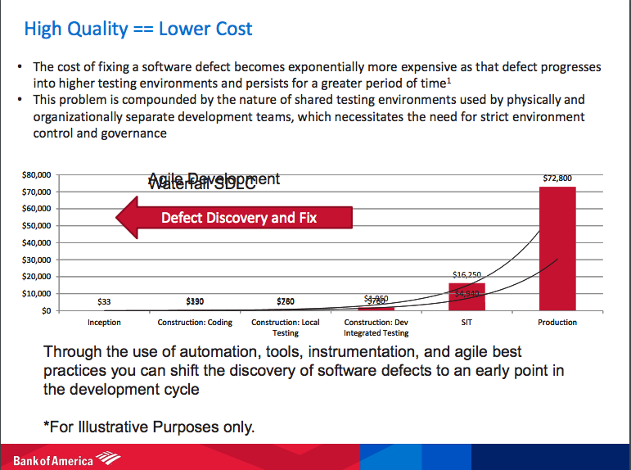
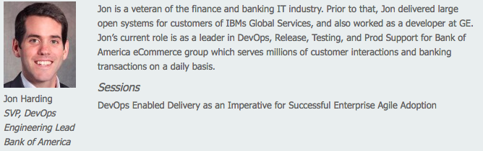
Fast Feedback = Higher Quality = Lower $$$

Slide 23



Introducing RBC Wealth Mgmt.
A Digital Winner

Slide 24
Yesterday…
Test cases needed to be written and uploaded to ALM
Manual test cases stipulated the design for the automation scripts
Development and maintenance effort was moderate to high
New changes and enhancements needed to be updated in every individual test case
The percentage of actual functional test coverage was always debatable
Much longer ROI cycle
Automation scripts created from scratch with limited reusability
Automation artifacts needed to be created manually
Tested applications on real devices or Emulators

Slide 25
Today (DEV/OPS MOBILE AUTOMATION)

Slide 26
The path to tomorrow…
Improved efficiency – Faster Development Cycle
Higher Quality – More Defects found earlier in the process
Optimized Test cases with more coverage
Reduced creation and maintenance cost equaling increased ROI
Parallel executions for quicker results
Increased manageability – better collaboration with external tools
FY2018 Goal
  Collaborate with Business Analyst / Business System Analyst to create base model
  Integrate Requirement Tools (Rally, Doors, etc.)
  Reduce QA cost with increased test coverage
  Continued maturity from QA (Quality Assurance) to QE (Quality Engineering)

