Slide 1
Kanban For Quality Management
October 12, 2017

Slide 2
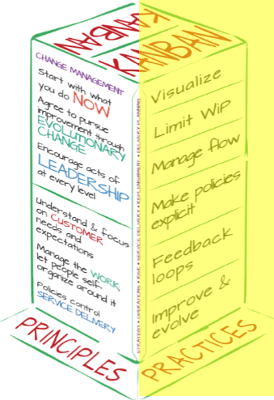
What is Kanban?
Wikipedia says “Kanban is a method for visualizing the flow of work, in order to balance demand with available capacity and spot bottlenecks. Work items are visualized to give participants a view of progress and process, from start to finish. Team members pull work as capacity permits, rather than work being pushed into the process when requested.”
Notes:
KB is set of practices and principles > we will focus on the practices today.
Start simple: execute > learn > iterate. Work visible, now what? Manage flow > Set policies > WIP

Slide 3
Sound Familiar?

Slide 4
Recommended Reading

Slide 5
Why Kanbanize?
It is an inexpensive and fully customizable tools that provides the base Kanban principle framework. Oh yeah, and the analytics engine within the tool is awesome!
Using Kanbanize to implement and manage our interpretation of Kanban has significantly helped us achieve traction with our operational quality initiatives.

Slide 6
End Goal: Quality!
Three Deep Quality Policy
Quality is our internal and external customers' perception of the negotiated value of Three Deep’s work.
Quality has many characteristics, aspects, and dimensions. Organizationally we have to align on the fact that quality is simply a measure of satisfaction.
Develop and execute processes that are defined and measurable.
Hold each other accountable for continued quality improvement.
Strive for the highest level of satisfaction by being accountable to upstream and downstream effects and by managing and challenging quality at every touch point.

Slide 7
Agenda
Kanban Core Practices:
Visualize Your Work
Manage Work Flow & Limit WIP (Work In Progress)
Set Explicit Policies
Improve & Evolve
Examples
Q&A

Slide 8
Yeah, we tried this too.
Issues:
It worked ok (when everyone was in the office).
Post-Its were moved once a day, at best.
Grouping, or categorizing cards was difficult.
No task assignment. Who is doing the work?
Reverse order / Bug fix visibility
The sticky stuff doesn’t last forever – falling cards
Cross-functional teams.
Visualize Your Work

Slide 9
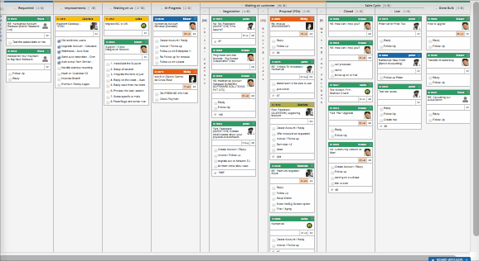
Kanbanize to the rescue.
Benefits:
A digital board, accessed from anywhere.
Cards assigned to individuals and moved as work is completed.
Grouping, or categorizing cards by delivery team, account, project, work type, etc.
Easily move cards forward, backwards, or to another board (with historical tracking).
Notifications upon card movement.
All work is visible.
Visualize Your Work
Notes:
Started with Dev team 4 four years ago, ramped up additional teams and now we have all delivery teams and operations teams using Kanbanize

Slide 10
Manage Work Flow: Value Streams
Define Work Types (Class of Service)
We standardized on Project – Ad Hoc Maintenance
Expedite
Define Workflow (Value Steams)
All teams required to have On Deck |Ready Work | In Progress | Review | Done
Some teams built out additional workflow.
Value stream mapping is a lean-management method for analyzing the current state and designing a future state for the series of events that take a product or service from its beginning through to the customer.
Notes:
Generic value stream. BUT how does work flow through each circle? DEV wanted more REVIEW columns to better represent their work flow. Again we started simple, with basic columns and expanded / iterated over time.

Slide 11
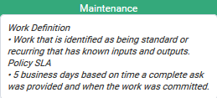
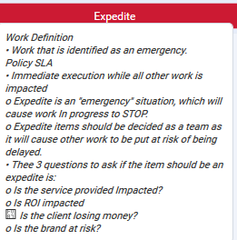
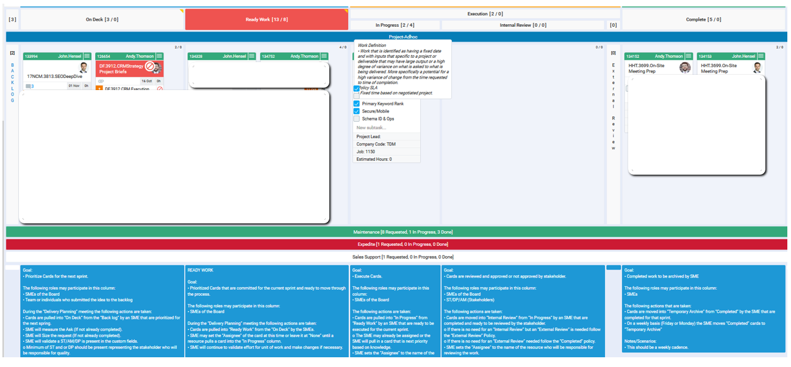
Manage Work Flow: Explicit Policies
Standards and policies are great….. IF people remember / follow them.
Policies are maintained across all boards within Kanbanize
Each workflow column also has an Explicit Policy
Notes:
Each column policy dictates the pre and post conditions, providing instruction and policy governance of how the boards are used. Each lane policy sets expectations for delivery.

Slide 12
Set & Manage WIP
Work In Progress
We have become a multi-task society. Multi-tasking defeats focus and productivity.
Kanban helps us to stay focused to complete a task then pick up the next task in queue. Work is pulled in to workflow rather than being pushed in to it.
How much work can one person, or team, commit to in a given time period?
WIP Limits
Start with where you are / what you do.
We tracked # Cards Crated / Finished to determine WIP
WIP Limits were established and are easily identified when exceeded.
Notes:
Most teams didn’t know what their optimal capacity / throughput was. We started simple, measure and let the data tell the story, then iterate. We chose ‘soft WIP limits”.

Slide 13
Improve & Evolve
Metrics | Measurement | Governance
Metrics & Measurements
5 Day SLA: Maintenance
WIP Limits
Defects (re-work rate)
Throughput
Blocks / Resolution Time
Overdue Cards
Governance
Runtime Policies
Public Reports
Actionable Scorecards
Feedback Loops
Notes:
Will get to all of the quality measure and components, but first a few examples.

Slide 14
Perceptions
PM: “Web Dev projects are ALWAYS late and over budget.”
Developer: “Requirements are constantly changing and no one is managing scope.” Tester: “We wouldn’t always be squeezed for time if the dev team unit tested before having us test.
Late and over budget are pretty easy to track. The WHY is a bit trickier, yeah?
Notes:
This is a recent snap shot, but we evolved to here. Started simple with a custom field called REWORK. Any time a card was moved backwards on the Dev board it was counted as REWORK. 2 months of collecting that data showed nearly 40% rework. Dev team broke down in to categories of re-work, added scope change, etc – measured weekly, put on scorecard and took measure to improve.

Slide 15
Perceptions
Account Manager (looking only at due dates): “The email team is not meeting their SLA’s”
Measurement says they are meeting the 5 day SLA – external approvals are taking way too long. Time to reset client expectations.

Slide 16
Gut Checks
How are we performing against our WIP’s
Notes:
Our work is highly variable, and often dependent on upstream effects. We can quickly see where anomalies lie and course correct as needed.

Slide 17
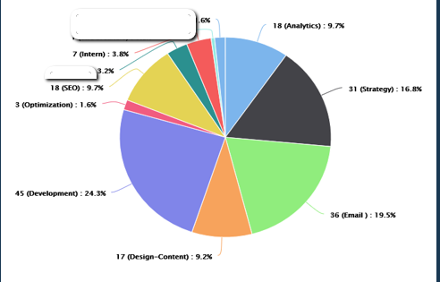
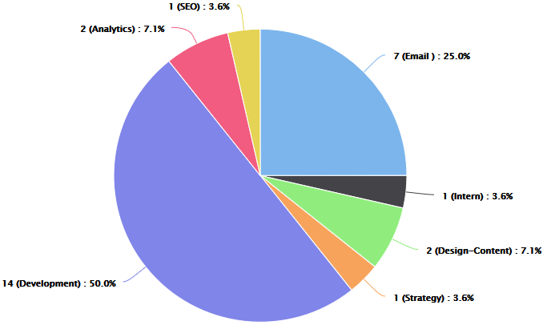
Data Accessibility / Visibility Distribution of Work
Active Cards
Blocked Cards
Notes:
This view is by Board. Easy data slicer to view how relevant to your / your role: By Account – By Job, Etc.

Slide 18
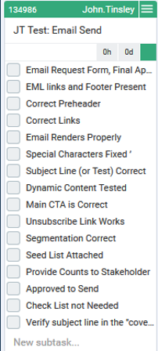
Kanbanize Standardization For Quality
Template Types: Checklists
Runtime Policies:
Recurring Cards: Retainer, Delivery Planning
IFTTT: Notifications, Process Kick-Off
Card Management: Blocks, WIP Overrides
Custom Fields: Used for Metrics
Notes:
By using template types in Kanbanize we can now automatically apply checklist, sub-tasks, etc to a card by applying a template. For check lists we started with basic elements related to the work type and class, we iterate and add new items as needed.
Kanbanize can be used operationally too, not just for delivering work> HR example. New Hire: Payroll, PC, Onboarding Sessions, Business Cards, etc.
IF due date this week AND card sits in On Deck, notify PM

Slide 19
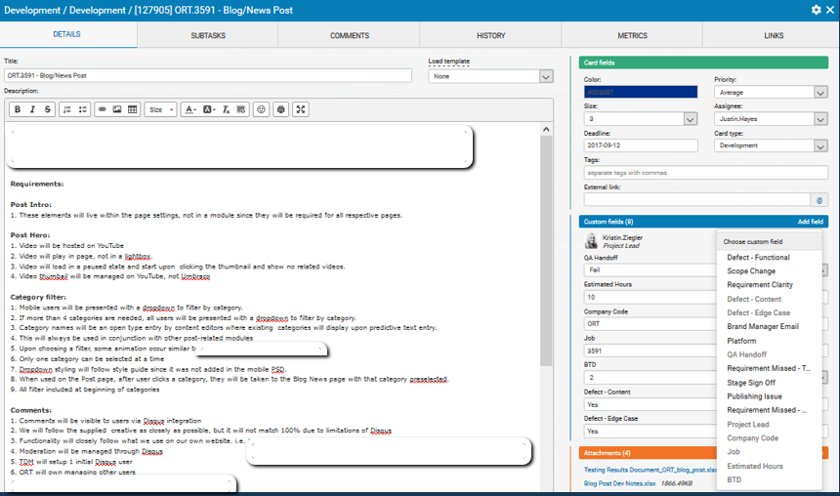
Kanbanize Standardization For Quality
Notes:
Custom fields are used for measurement of things like defect, scope change, etc.

Slide 20
Kanbanize Standardization For Quality

Slide 21
Kanban: Operational Execution Feedback Loops
Notes:
We had confusion and clarity on the operational meetings put in place to support the Kanban method. We constructed the above table, aligned the organization to it, and now the meeting invites contain the meeting specific details of purpose, focus, intent, and attendance.

Slide 22
End Goal: Quality!
Three Deep Quality Policy
Quality is our internal and external customers' perception of the negotiated value of Three Deep’s work.
Quality has many characteristics, aspects, and dimensions. Organizationally we have to align on the fact that quality is simply a measure of satisfaction.
Develop and execute processes that are defined and measurable.
Hold each other accountable for continued quality improvement.
Strive for the highest level of satisfaction by being accountable to upstream and downstream effects and by managing and challenging quality at every touch point.

Slide 23
Question & Answer

